Slide 1
Unit V
Spectroscopic Techniques Laws of Spectroscopy
Dr. P. G. Umape
Assistant Professor
First Year Engineering Department
Pune Institute of Computer Technology

Slide 2
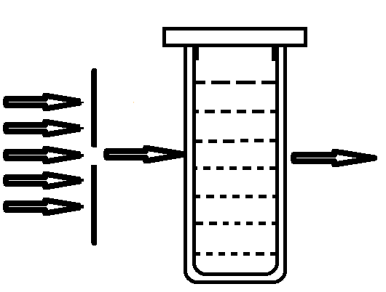


Basic Laws of Spectroscopy
Lambert’s Law:
When a beam of monochromatic light is allowed to pass through a transparent solution, the rate of decrease in intensity of light is directly proportional to increase in thickness of media.
Monochromatic light
$$−\frac{dI}{I0}∝db$$
$$−\frac{dI}{IO}=k db$$
I₀
I_{t}
Where, I₀ is the intensity of incident light
dI is the small change in intensity
db is the small change in thickness of media
Cuvette

Slide 3
Basic Laws of Spectroscopy
Lambert’s Law:
Now integrate the equation with the limits
I = I₀ when b = 0 and I = I_{t} when b = b
Where, I₀ is the intensity of incident light
I_{t} is the intensity of transmitted light
b is the thickness of media
k is absorption coefficient for the given wavelength and medium

Slide 4
Basic Laws of Spectroscopy
Lambert’s Law:
Hence based on the derivation, Lambert’s law can be stated as: The intensity of transmitted light I_{t} decreases exponentially as the thickness of absorbing medium increases, for the medium of fixed concentration.

Slide 5

Basic Laws of Spectroscopy
Beer’s law:
When a beam of monochromatic light is allowed to pass through a transparent solution, the rate of decrease in intensity of light is directly proportional to increase in concentration of solution.
Monochromatic light
$$−\frac{dI}{IO}∝dc$$
$$−\frac{dI}{IO}=k′ dc$$
I₀
I_{t}
Where, I₀ is the intensity of incident light
dI is the small change in intensity
dc is the small change in concentration of media
Cuvette

Slide 6
Basic Laws of Spectroscopy
Beer’s Law:
Now integrate the equation with the limits
I = I₀ when c = 0 and I = I_{t} when c = c
Where, I₀ is the intensity of incident light
I_{t} is the intensity of transmitted light
c is the concentration of media
k’ is absorption coefficient for the given wavelength and medium

Slide 7
Basic Laws of Spectroscopy
Beer’s Law:
Hence based on the derivation, Beer’s law can be stated as: The intensity of transmitted light I_{t} decreases exponentially as the concentration of absorbing medium increases, for the medium of fixed thickness.

Slide 8
Basic Laws of Spectroscopy
Lambert-Beer’s law:
When a beam of monochromatic light is allowed to pass through a transparent solution, the intensity of transmitted light decreases with increase in thickness as well as concentration of media.
Monochromatic light
I₀
I_{t}
Where, I₀ is the intensity of incident light
dI is the small change in intensity
dx is the small change in thickness of media
dc is the small change in concentration of media
Cuvette

Slide 9

Basic Laws of Spectroscopy
Lamber-Beer’s Law:
Now integrate the equation with the limits
$$ln\frac{I_{0}}{I_{t}}=K.b.c$$
$$log\frac{I_{0}}{I_{t}}=\frac{1}{2.303}K.b.c$$
$$log\frac{I_{0}}{I_{t}}=ɛ.b.c$$
$$A=ɛ.b.c$$
Where, I₀ is the intensity of incident light
I_{t} is the intensity of transmitted light
b is the thickness of media
c is the concentration of media
є is absorptivity constant

Slide 10
Basic Laws of Spectroscopy
Lambert-Beer’s Law:
‘A’ is called as absorbance
While ‘T’ is called as transmittance
is called as molar absorptivity or molar extinction coefficient
It is the absorptivity for a solution having 1 molar concentration and 1cm path length.

Slide 11
Summary
Lambert’s law
Beer’s law
Combined law/Lambert-beer’s law
Absorption
Transmission
Molar absorptivity/Molar extinction coefficient

